Slide 1

Hotel Bookings
SQL And NoSQL
Assignment 3
Biraj Parikh

Slide 2
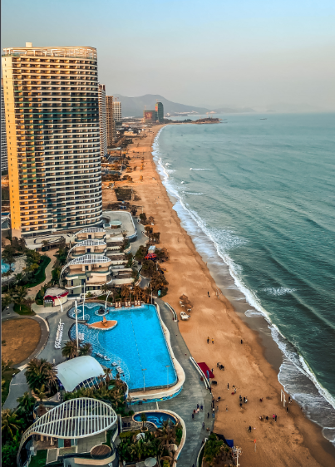
Content:
This data set contains booking information for a city hotel and a resort hotel and includes information such as when the booking was made, length of stay, the number of adults, children, and/or babies, and the number of available parking spaces, among other things.
Source: https://www.kaggle.com/jessemostipak/hotel-booking-demand

Slide 3
Objectives: This dataset can help answer following questions
Have you ever wondered when the best time of year to book a hotel room is?
What is the optimal length of stay in order to get the best daily rate?
What if you wanted to predict whether or not a guest would actually come or not ? (Data Modeling)

Slide 4
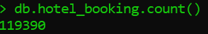
Importing csv data
Using command line interface to import the data:
mongoimport -d project -c hotel_booking --type csv --drop --file "D:\My stuff\IU Courses\SEM 2\SQL AND NOSQL\datasets\Hotel\hotel_bookings.csv" –headerline
The above command line will create database ‘project’ and collection ‘hotel_booking’

Slide 5
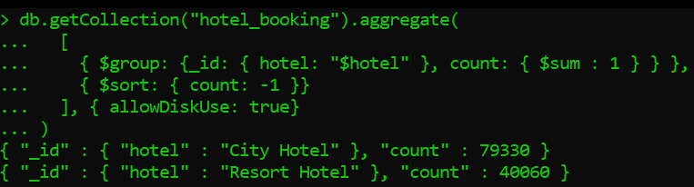
Checking the distribution of the hotels
The dataset contains data from two different hotels.
Most guest prefer to book City hotels compared to Resort hotels.

Slide 6
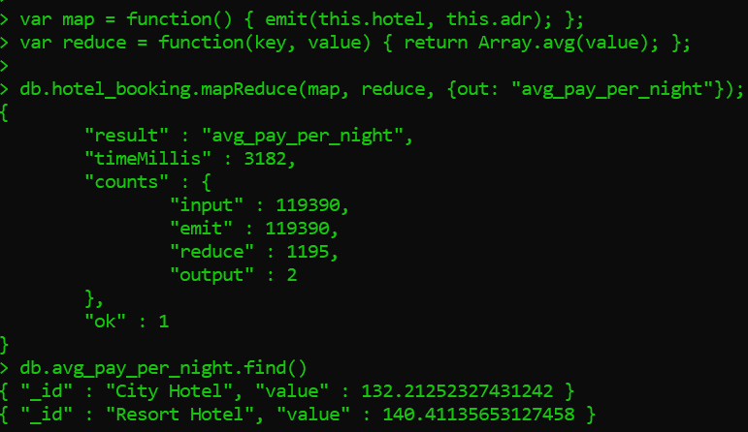

How much do guests pay for a room per night?
Resort hotel: 47.49 € per night and person. City hotel: 59.27 € per night and person.
Resort hotel: 140.41 per night.
City hotel: 132.22 per night.
Thus, guest pay a bit extra for Resort hotel per night compared to City hotel.

Slide 7
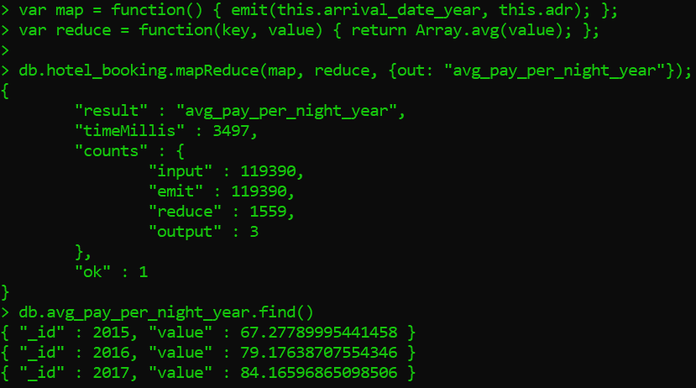
How does the price per night vary over the year?
Average pay per night increases every year regardless of type of hotel. That make sense.

Slide 8
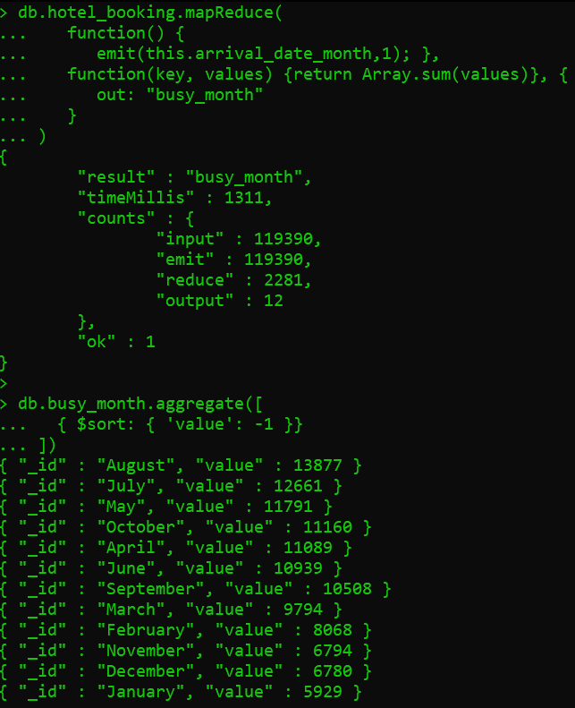
Which are the busiest month?
As expected the busiest month for all the years in the given data are over the summer i.e. from May to August.

Slide 9
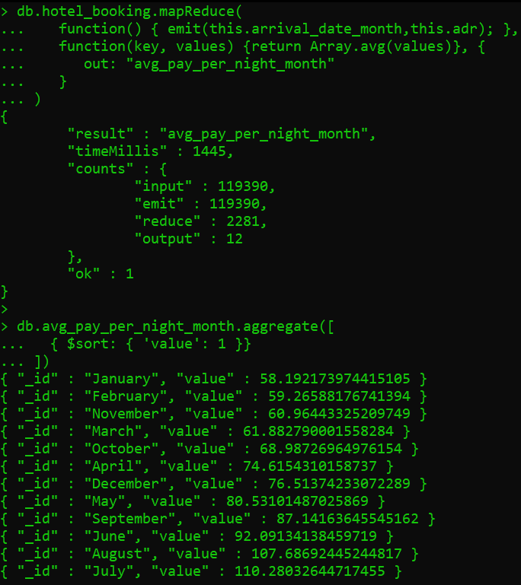
Let’s find the average price per night for all the years over all the month.
The prices are much higher in the month from May to September i.e. during the summer.
Thus, the best time to book the hotel room is during the initial month from January to March.
Spring Break is the best option to hangout with the family with cheap hotel rates.

Slide 10
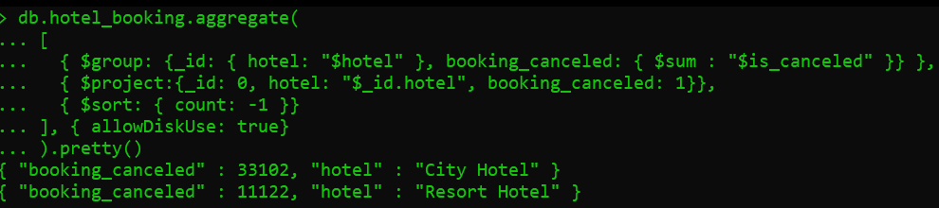
How many bookings were canceled?
Total booking cancelled : 44224 (37%)
Resort hotel booking cancelled : 11122 (28%)
City hotel booking cancelled : 33102 (42%)

Slide 11
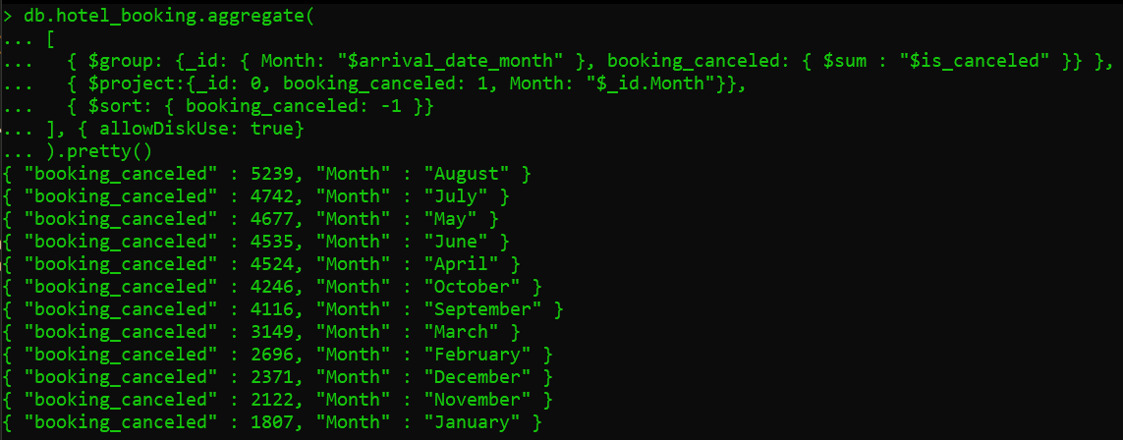
Which month have the highest number of cancelations?
As before, since most number of hotel bookings are done from May to August, thus we can expect a lot of booking cancelations during that time.

Slide 12
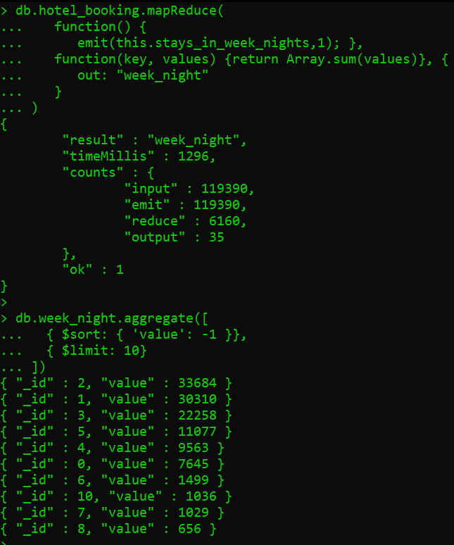
How long do people stay at the hotels?
Most number of hotel bookings are targeted towards 1-4 days. Thus, optimal length of stay would be 3-4 days during the month from January to March to get the best rate.

Slide 13
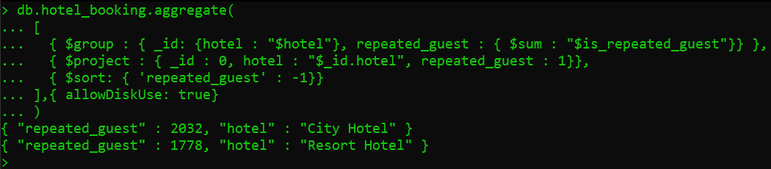
How many guest repeat their bookings?
Resort Hotel repeated guest : 1778 (1.4%)
City Hotel repeated guest : 2032 (1.7%)
Total repeated guest : 3810 (3.1%)
Comparatively, the guest prefer to book again in the city hotels than resort hotels.

Slide 14
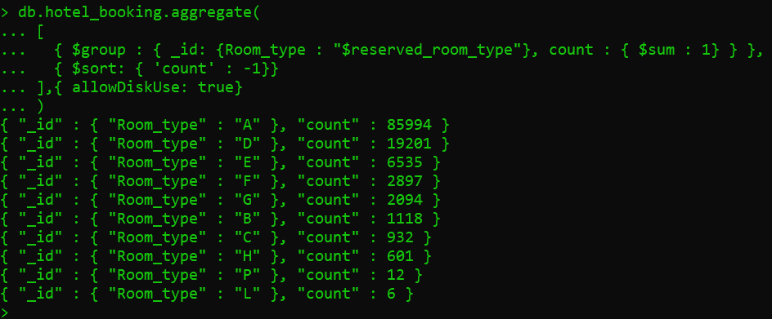
What type of rooms guest prefer?
As obvious, majority of the guest prefer luxurious rooms to stay while booking.

Slide 15
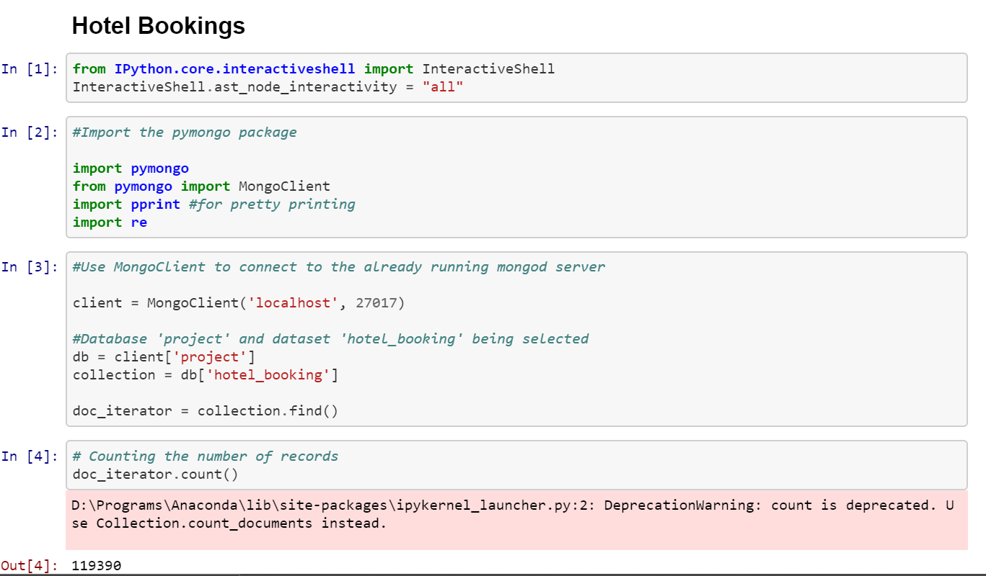
Data Modeling:
Used PyMongo to establish the Client connection.

Slide 16
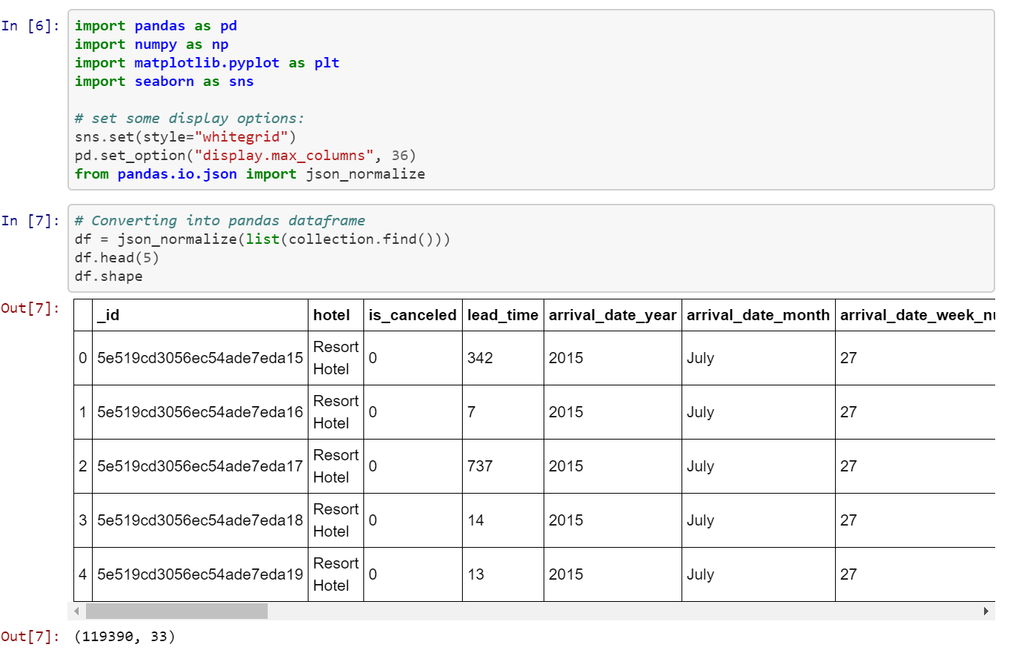
Converting to pandas DataFrame:

Slide 17
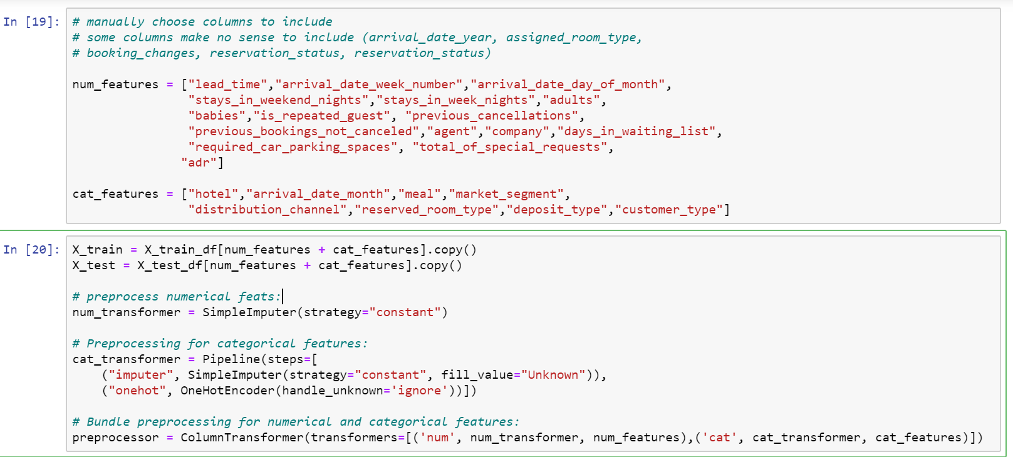
Data Preprocessing:

Slide 18
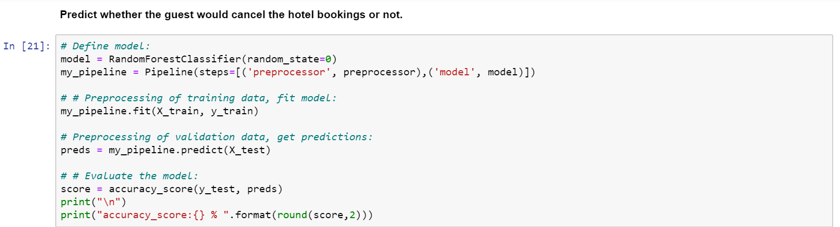
Applying the Machine learning Model:
accuracy_score: 86 %
Thus, the hotel owners can make a guess whether the guest would cancel the hotel bookings or not using the above prediction.
Complete Data Analysis: https://github.com/birajparikh16/Exploratory-Data-Analysis-Hotel-Bookings

Slide 19
Thank you.

